Slide 1
Milestone 6 – Validation

Slide 2
Agenda
1. Project overview
2. Output Data
3. Modifications in model
4. Results of the Validation Experiments
5. Comparisons of Real and Simulated Data
6. Limitations & Assumptions
7. Project budget
8. Project progress
9. Lessons learned
Milestone 6 - Validation

Slide 3
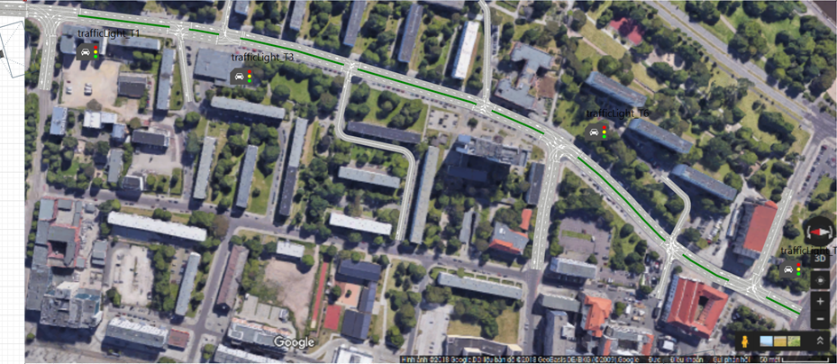
Project Overview - Revisited
Milestone 6 - Validation

Slide 4
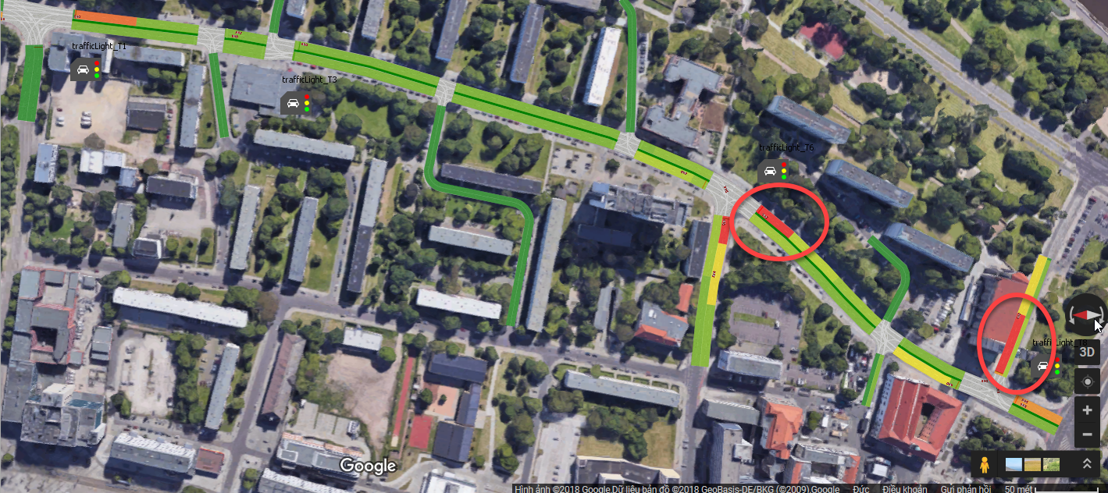
Output Data
Queue Lengths in Johannisbergstraße & at the crossroad of Julius-Bremer-Straße
Travelling time (between Listemannstraße and Johannisbergstraße)

Slide 5
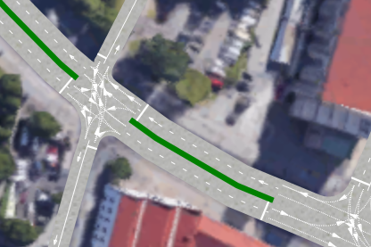
Modifications
Modeling time is changed to 2 hours as rush hours and non rush hours for synchronisation of all car sources
Corrections on turning lanes
Milestone 6 - Validation

Slide 6
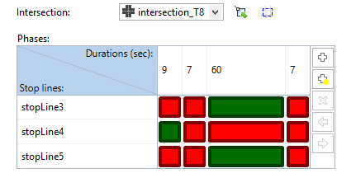
Modifications
Some corrections for traffic light timings
Traffic light phases
Interarrival rate of pedestrian in Mühlenstraße
Milestone 6 - Validation

Slide 7
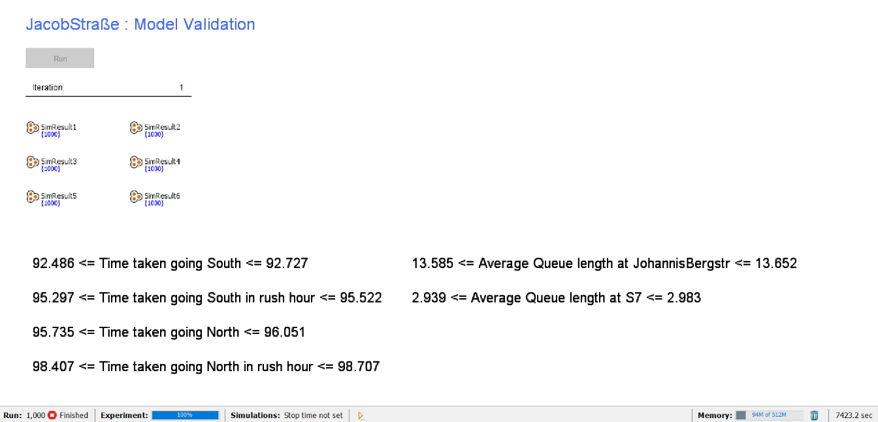
Results of the Validation Experiments
Level of Significance: 0,005
Number of Replications: 1000
Milestone 6 - Validation

Slide 8
Comparisons of Real and Simulated Data
Queue Lengths
 | Johannisbergstraße | Near Julius-Bremer-Straße
Average of Real World Data | 13 | 8,273
Confidence Interval Lower Bound (Simulation Model) | 13,585 | 2,939
Confidence Interval Upper Bound (Simulation Model) | 13,652 | 2,983
Milestone 6 - Validation

Slide 9
Comparisons of Real and Simulated Data
Traveling time (Listemannstraße – Johannisbergstraße)
 | Non-Rush Hours |  | Rush Hours
 | North South | South North | North South | South North
Average of Real World Data | 92,5625 | 97,9375 | 101,1666667 | 92,06666667
Confidence Interval Lower Bound (Simulation Model) | 92,486 | 95,735 | 95,297 | 98,407
Confidence Interval Upper Bound (Simulation Model) | 92,727 | 96,051 | 95,522 | 98,707
Milestone 6 - Validation

Slide 10
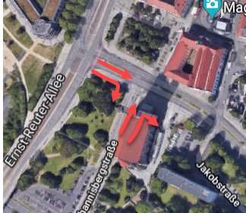
Limitations & Assumptions
Traffic light timings are stable (Except Mühlenstraße)
Pedestrian arrivals are added to the model only for Mühlenstraße
Only one traffic light is used on the roads with turnings
Milestone 6 - Validation

Slide 11
Limitations & Assumptions
4. No bikes and buses.
5. Streets (Blaubeilstraße, Peterstraße, Mühlenstraße, Neustädter Str.) with low traffic volumes have no influence on our model (Number of inbound cars = number of outbound cars)
6. Turning probabilities are stable.

Slide 12
Project Progress
Milestone 6 - Validation

Slide 13
Project Budget
Milestone 6 - Validation

Slide 14

Lessons Learned
Problem #1: Reworking on previous subjects
Problem #2: Changes made in the goal
Solution: Spending more time, working more detailed on planning and searching part at the beginning
Milestone 6 - Validation

Slide 15
Thank you for your attension!
Milestone 6 - Validation

